Slide 1





www.reallygreatsite.com
TITANIC
SURVIVAL
PREDICTION
A Classification Problem
By Mrudula Kamdi

Slide 2


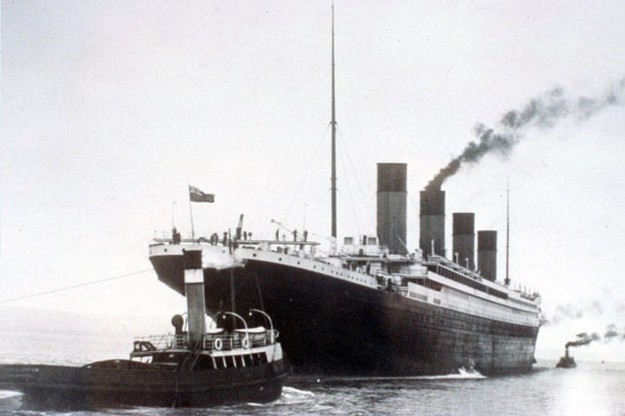
Introduction
"The RMS Titanic was a British passenger liner that sank in the North Atlantic Ocean in 1912, resulting in the deaths of over 1,500 people."
- Largest ship in the world at the time
- Considered unsinkable
- Tragic accident that shocked the world

Slide 3



Why Predict Titanic Survival?
"Predicting survival rates can help us understand the factors that contributed to survival and improve emergency response strategies for future disasters."
- Understanding factors that contributed to survival
- Improving emergency response strategies
- Informing policy decisions for disaster preparedness

Slide 4
Model Selection
Possible Models
Model choosen :
Why Logistics Regression
1. Logistic Regression
2. Decision Trees
3. Random Forest
4. Support Vector Machines (SVM)
5. Neural Networks
Well suited for Binary classification
Provide interpretable result
Efficient and simple to implement
Can handle imbalance dataset
Logistic Regression:
A popular choice for binary classification problems like Titanic Survival Prediction.

Slide 5
Data Collection and Preparation
Data Collection
Data Transformation
Titanic dataset from Kaggle
Number of rows: 89
Number of columns: 12
Categorical variable encoding: one-hot encoding
Scaling/normalizing: StandardScaler
Data Cleaning
Data Spilting
Missing value handling: mean/median imputation
Splitting data into training and testing sets
Training set: 70% of Data
Testing set: 30% of Data

Slide 6
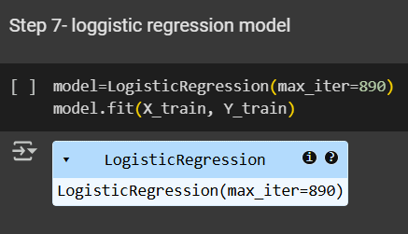
Building a Model
Training the loggistic regression model on the prepared data
Model Traing
Model Evulation
Model Accuracy -0.80
Recall-0.85
Pedictions-0.82
F1 Score-0.84

Slide 7
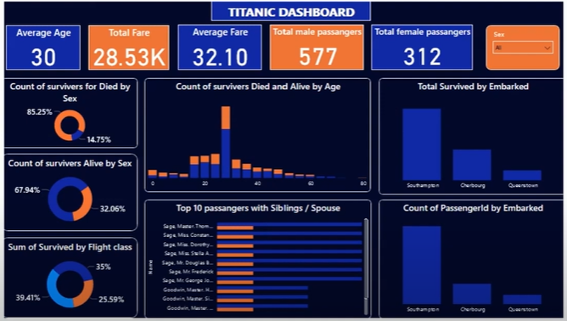
Power BI dashboard:

Slide 8
Results and Insights
Overall survival rate: About 38% of passengers survived
First-class passengers had a higher survival rate than lower-class passenger.
More women survived compared to men

Slide 9


Conclusion
A Logistic Regression model was built for Titanic survival prediction with 80% accuracy using data from Kaggle. Missing values were handled, and feature engineering was applied to enhance predictions. Key survival factors include gender, class, age, and fare, with women and first-class passengers having higher survival rates. While effective, the model assumes linear relationships; improvements like advanced models (Random Forest, Neural Networks) could further enhance accuracy.

Slide 10
Refrences
Titanic ML Tutorial (Kaggle): https://www.kaggle.com/code/startupsci/titanic-data-science-solutions
Titanic Survival Prediction with Logistic Regression (GeeksforGeeks): https://www.geeksforgeeks.org/titanic-survival-prediction-using-machine-learning/
Kaggle Titanic Dataset: https://www.kaggle.com/c/titanic

Slide 11


THANK YOU!

